Slide 1
Micro credit loan project
By
Ria maitra

Slide 2
introduction
A Microfinance Institution (MFI) is an organization that offers financial services to low income populations. MFS becomes very useful when targeting especially the unbanked poor families living in remote areas with not much sources of income. The Microfinance services provided by MFI are Group Loans, Agricultural Loans, Individual Business Loans and so on.

Slide 3
Problem statement
Though Microfinance Institutions enables people expand their present opportunities by providing easy access to credit but still MFI faces the challenges of credit risk. As the rate of interest id high than any commercial bank, often people fail to pay their loan. Also, because of geographic factors makes it difficult to communicate with clients of far-flung areas which create a problem in growth and expansion of the organization.

Slide 4
objective
To know the relationship between the independent variables with the dependent variable.
To build a model which best classifies default and non-default customers.

Slide 5
Data collection
Secondary source of data is provided by a MFI client.
Format of data is csv file.
Data set contains 209593 rows and 33 features.

Slide 6
Data variables

Slide 7
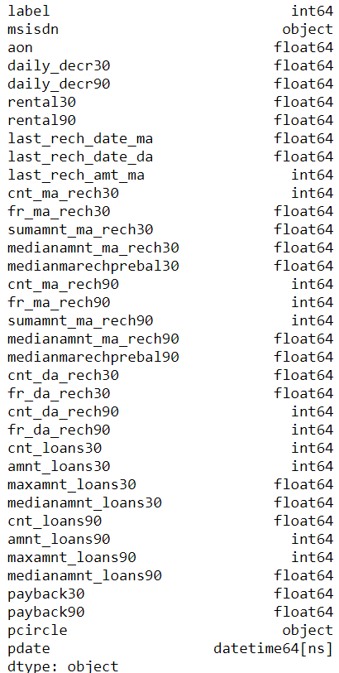
Data type

Slide 8
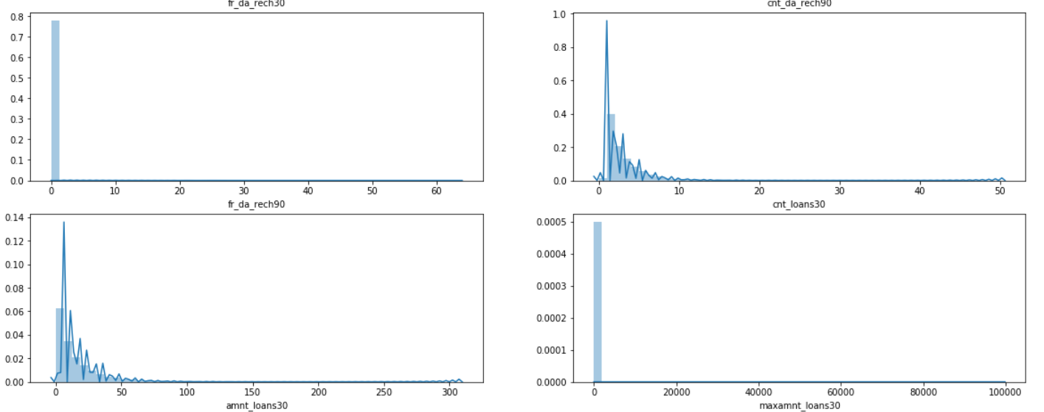
Univariate analysis
All features are right skewed also few features has negative values too.

Slide 9
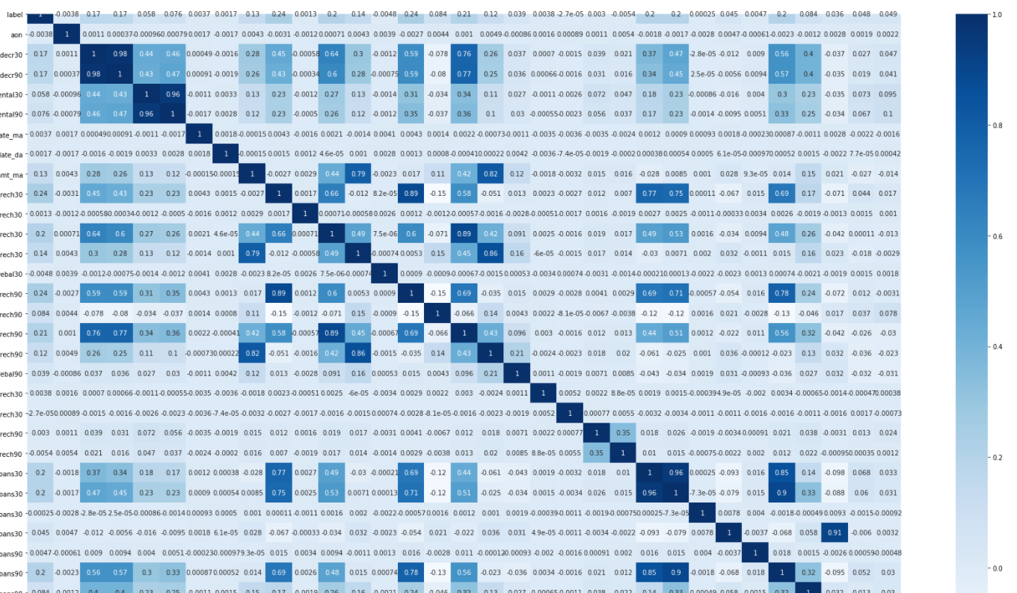
Bivariate analysis
Correlation matrix
Dark shades represent high correlation.

Slide 10
Following independent variables are highly correlated with dependent variable:
* daily_decr30 * daily_decr90 * rental30 * rental90 * last_rech_amt_m
* cnt_ma_rech30 * sumamnt_ma_rech30 * medianamnt_ma_rech30
* cnt_ma_rech90 * sumamnt_ma_rech90 * medianamnt_ma_rech90
* cnt_loans30 * amnt_loans30 * amnt_loans90

Slide 11
Model deployment
Following models are used :
Logistic Regression
GaussianNB
Knn
DecisionTree
RandomForest

Slide 12
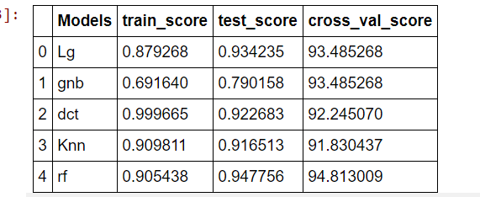
Evaluation metrics
Model Name | Test Score | True Negatives | False Negatives
Logistic Regression | 0.934 | 0.988 | 0.898
GaussianNB | 0.790 | 0.670 | 0.181
Decision Tree | 0.922 | 0.920 | 0.522
Knn | 0.916 | 0.910 | 0.539
Random Forest | 0.947 | 0.993 | 0.725

Slide 13
Conclusion
Random Forest is the best performing model with test score of 94% with high true negative value signifying the model is good in predicting default customer which was our main concern.
 | Test Score | True Negatives | True Positives
Random Forest | 0.947 | 0.993 | 0.725

Slide 14
Thank you

